Slide 1
Problem Solving
(Search)

Slide 2
Introduction
A knowledge base is a collection of facts about a certain subject
We need some inferencing mechanism that references the knowledge base to reason and draw conclusion
  Searching and pattern matching techniques are used
  Searching algorithms are used which examine the KB in an orderly way to solve the problem

Slide 3
Problem solving elements
The process of problem solving involves three elements:
  Problem states
    Define the problem situation and existing condition
      Initial state (s)
      Other states
      In tic-tac-toe the initial state is 3x3 grid of squares, as a player add X or 0, the problem state changes.
  Goal
    The objective, a final answer, result to be achieved
  Operators
    The procedure used to change from one state to another state and continue until a goal is reached
    An operator can be an algorithm
    A control strategy is used by operator
    In tic-tac-toe, maximizing ones options and minimizing the opponent’s option.

Slide 4
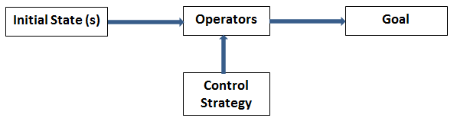
Problem solving elements-Relationship

Slide 5
State and search space
To define a problem, visualize a solution, or select a search method, it is often useful to express the problem in graphical terms.
This can be done by drawing a graph of the problem showing the various problem states and how they are interconnected.
The resulting graph is referred to as state graph or state space

Slide 6
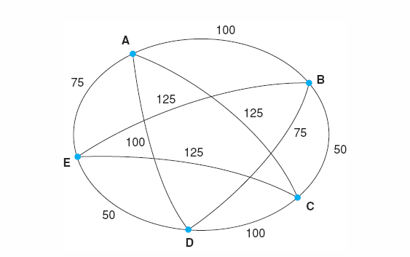
State graph
The Traveling salesperson problem
  Suppose a salesperson has five cities to visit and then must return home
  The goal of the problem is to find the shortest path for the salesperson to travel

Slide 7
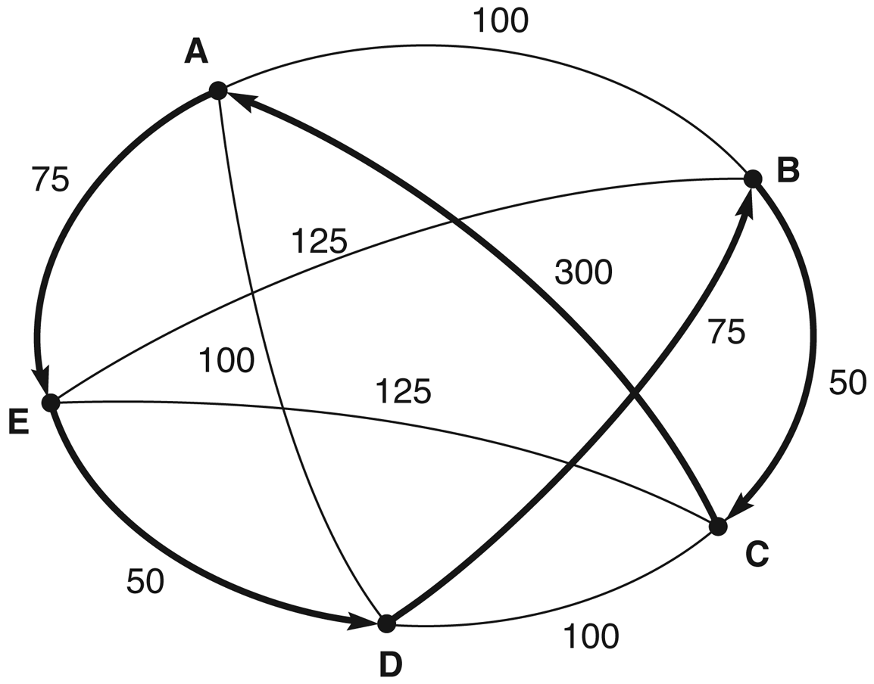
Nearest neighbor path
Nearest neighbor path
  = AEDBCA (550)
Minimal cost path
  = ABCDEA (375)

Slide 8
State Space Representation
In the state space representation of a problem, the nodes of a graph correspond to partial problem solution states and the arcs correspond to steps in a problem solving process
One or more initial states form the root of the graph
The graph also defines one or more goal conditions, which are solutions to a problem

Slide 9
State Space Representation
State space search characterizes problem solving as the process of finding a solution path form the start state to a goal
A goal may describe a state, such as winning board in tic-tac-toe game

Slide 10
Problem with state graph
Sometimes the repetition of a same path, having a cycle, infinitely is the main problem in graph
Solution
  Search tree is used to represent the problem and minimizes this problem

Slide 11
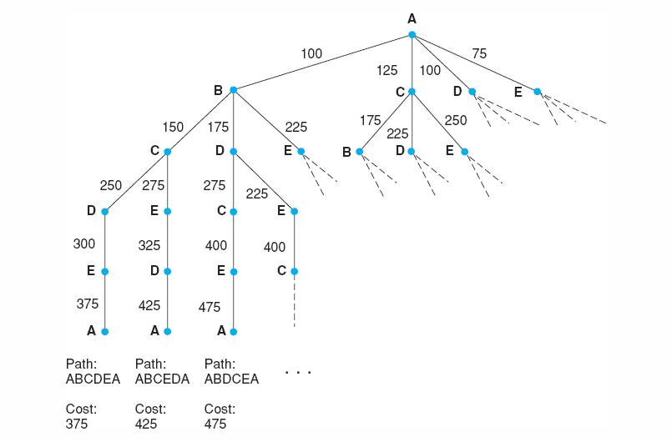
Search tree

Slide 12
Search tree
It is another way to represent the problem
The root node is called the initial state
The successor nodes are called the child nodes
The nodes are the various states in the search space
The arcs are operators used to move from one state to another state
Beginning at the root node, operators are applied to achieve new states

Slide 13
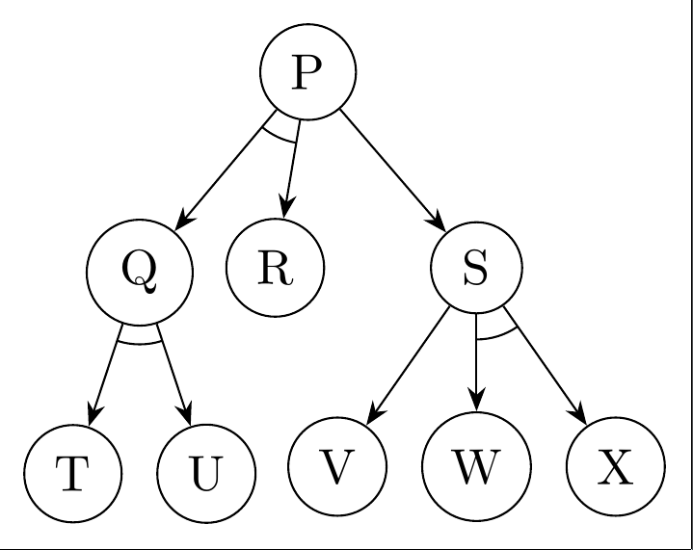
OR node and AND node
OR nodes
  If there is two or more branches from a node to the goal then we call them OR nodes
AND nodes
  If there is only a single path from one node to the goal state then these nodes are called AND nodes

Slide 14
Game tree
A game tree is a graph showing all possible states or plays in a game between two players
The game tree for “tac-tac-toe” is

Slide 15
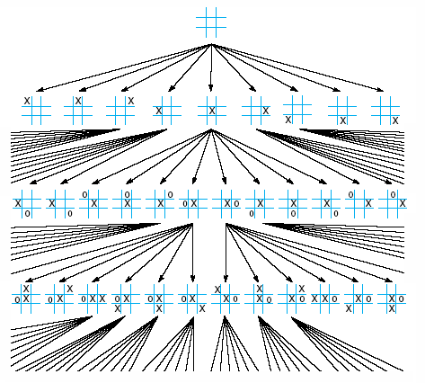

Slide 16
Search methods
There are two basic approaches to searching a state space:
Blind search
Heuristic search

Slide 17
Search methods
Blind search
  It is a collection of procedures used to search a state space
  Starts at the root node and generates successor states
  The search continue till the goal state is achieved
  Here, the whole space is searched in an orderly manner till the goal is achieved

Slide 18
Search methods
Heuristic search
  It is blind search that has been given some guidance or direction to reach the goal state

Slide 19
Search methods
Heuristic search
  It is blind search that has been given some guidance or direction to reach the goal state

Slide 20
Combinatorial Explosion
Blind search takes so much time with large problem that it suffers from combinatorial explosion
When many alternatives must be considered the search space expands exponentially
If N is average number of branches per node and D is the depth then
  Total Number of search = N^{D}
Tic Tac Toe= 362,880 nodes
Chess = 10 to the 120th power possible chess moves
Checkers game = 10 to the 40th power possible moves

Slide 21
Blind Search
Begin at the root node and go all the way to the goal
The operators and the order in which they are tried have no meaning
Brute force techniques
Takes a considerable amount of time to finds a solution
The practicality of the blind search lies in the time it takes to get to the solution
Often it suffers from unacceptable long computing time
However, for some simple problems → its practical to use blind search

Slide 22
Blind Search : Possibilities
  Depth-first search
  Breadth-first search
  Forward chaining
  Backward chaining

Slide 23
Search Strategies: Blind Search
Breadth-first search
Expand all the nodes of
one level first.
Depth-first search
Expand one of the nodes at
the deepest level.

Slide 24
Depth-first search
In DFS, when a state is examined, all of its children and their descendants are examined before any of its siblings

Slide 25
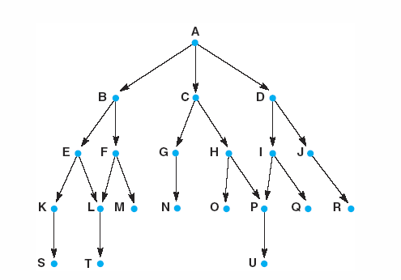
Depth-first search
Consider the tree
DFS results: ABEKSLTFMCGNHOPUDIQJR

Slide 26
Depth-first search
Properties of DFS
  If it is known that the solution path will be long, DFS will not spend time searching a large number of “shallow” states in the graph
  However, DFS may “lost” deep in a graph, missing short paths to a goal, or even stuck in an infinite loop
    To minimize this problem, depth limit can be defined, such a search is called depth bound.
    Educated guess or determined experimentally

Slide 27
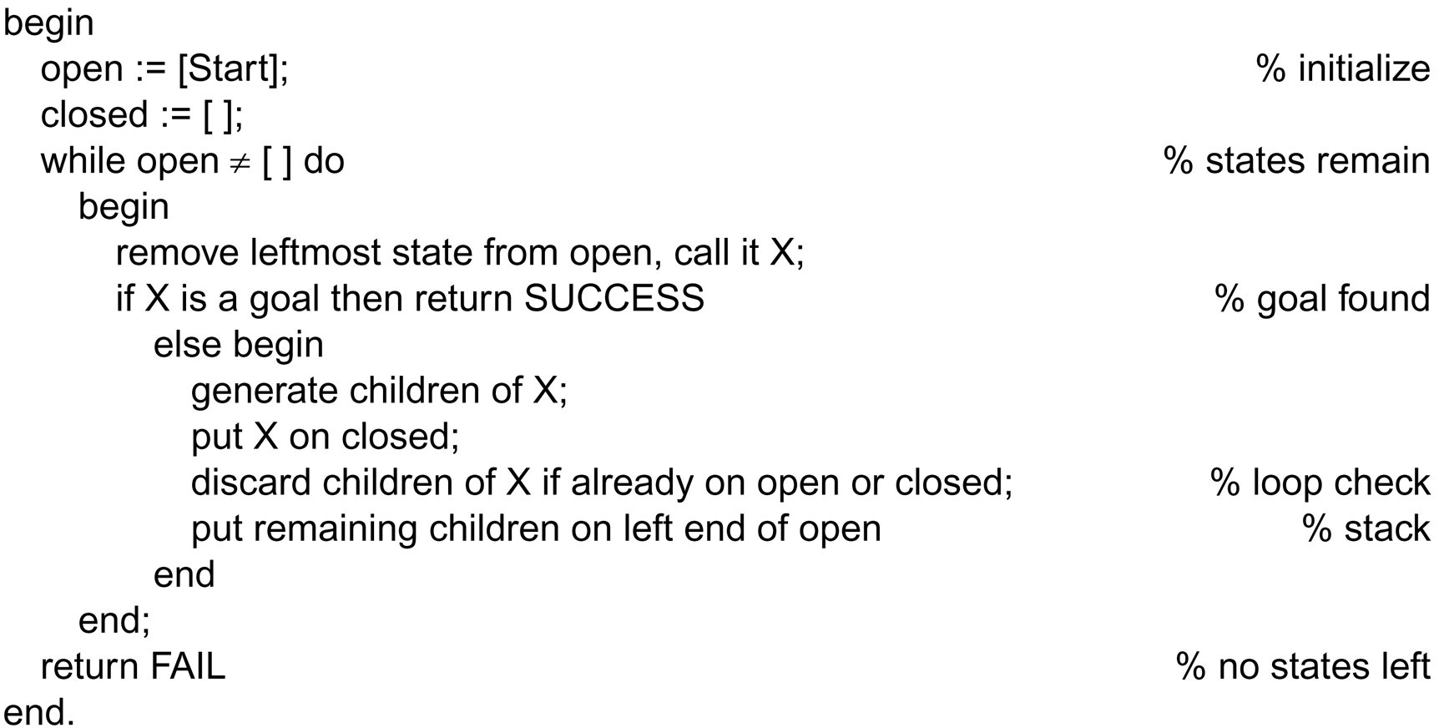
DFS algorithm

Slide 28
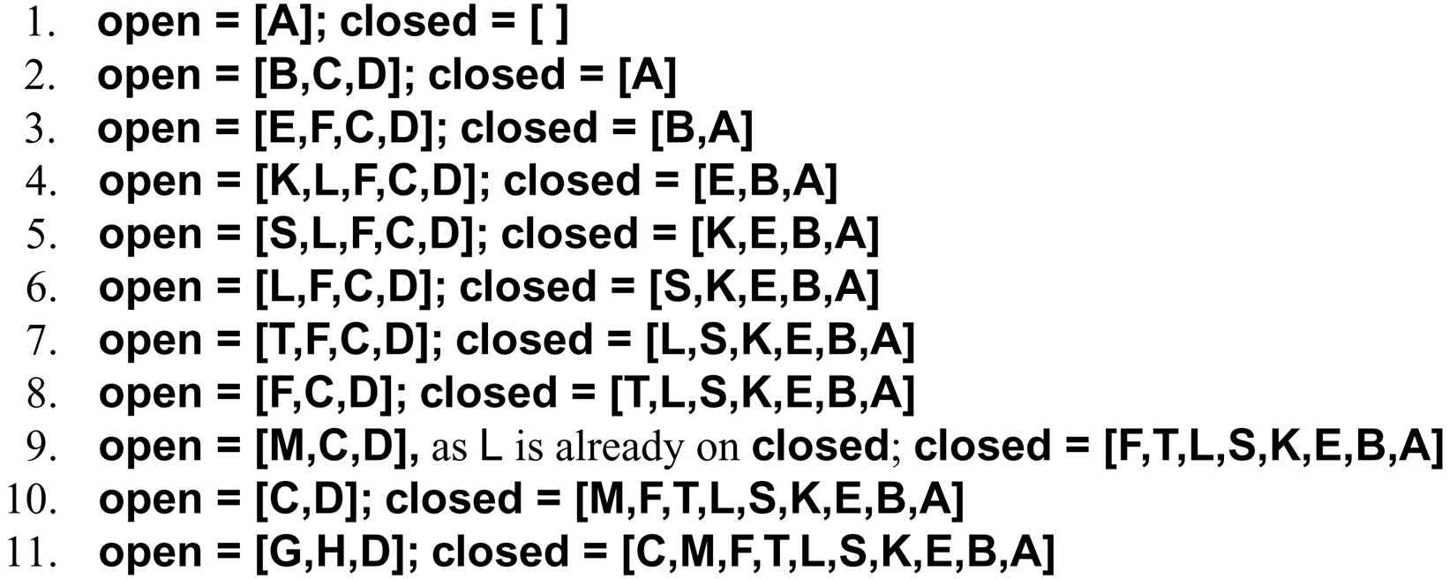
Simulation of DFS algo

Slide 29
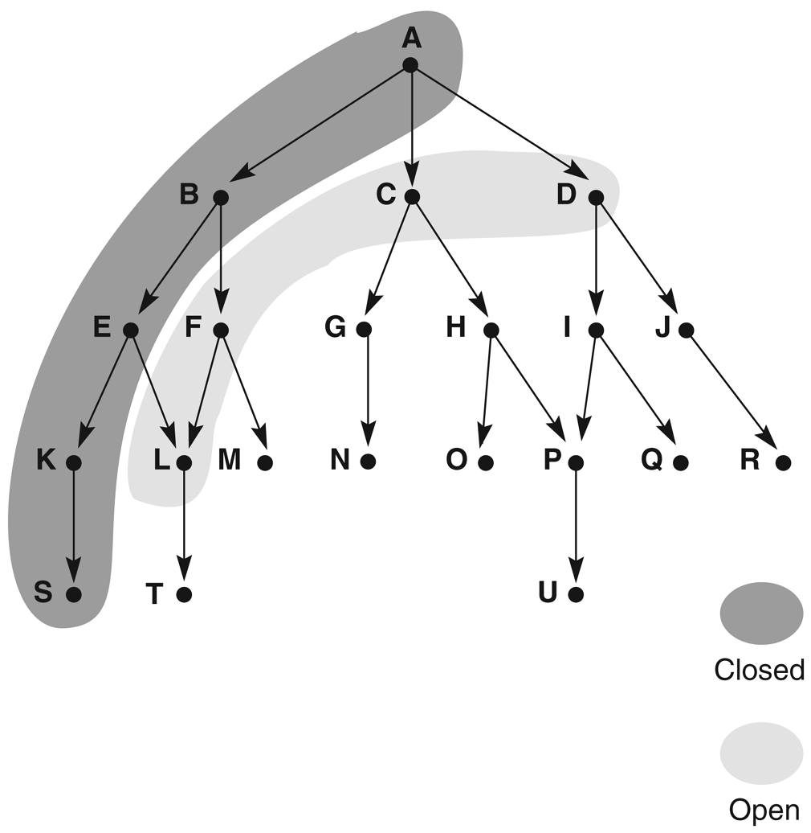
DFS

Slide 30
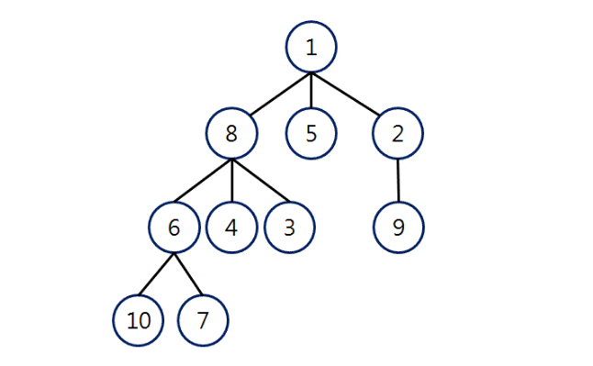

Slide 31
Breadth-first search
Breadth-first search explores the space in a level-by-level fashion
BFS results for the tree:
  ABCDEFGHIJKLMNOPQRSTU

Slide 32
Breadth-first search
Properties of BFS
  Because it always examines all nodes at level n before proceeding to level n+1, BFS always finds the shortest path to a goal
  In a problem have a simple solution, the solution will be found
  Unfortunately, if the states have a high average number of children, it may use all the memory before it find a solution

Slide 33
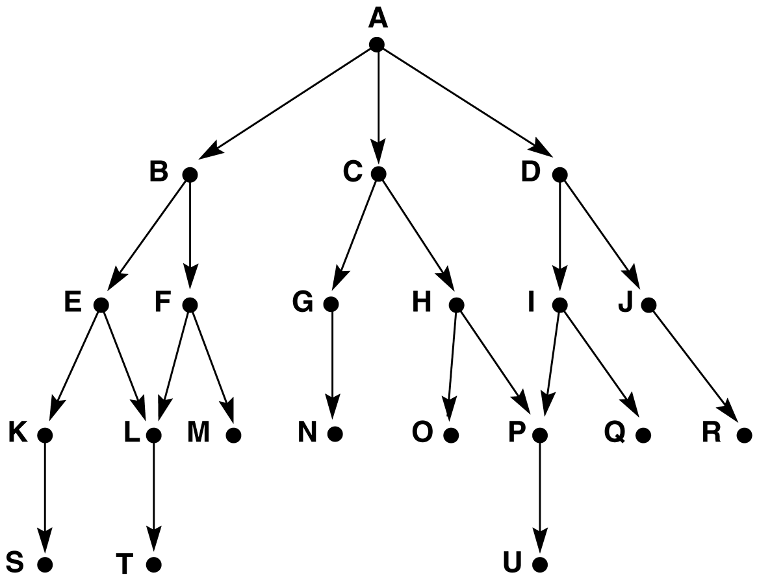
Graph for BFS

Slide 34
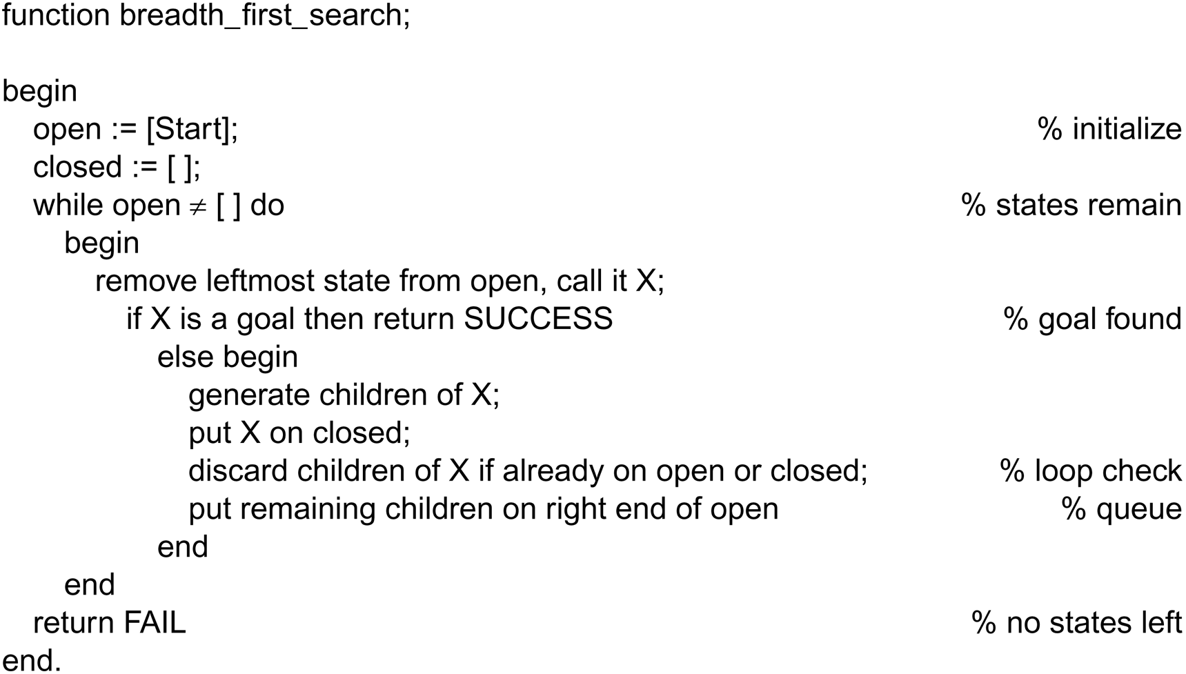
Breadth_first search algorithm

Slide 35
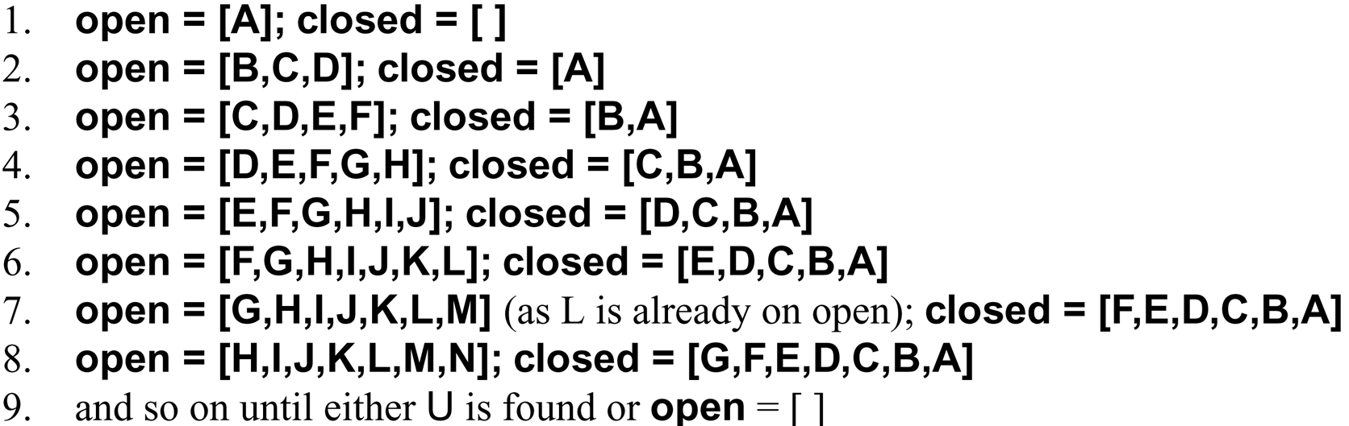
Simulation of BFS

Slide 36
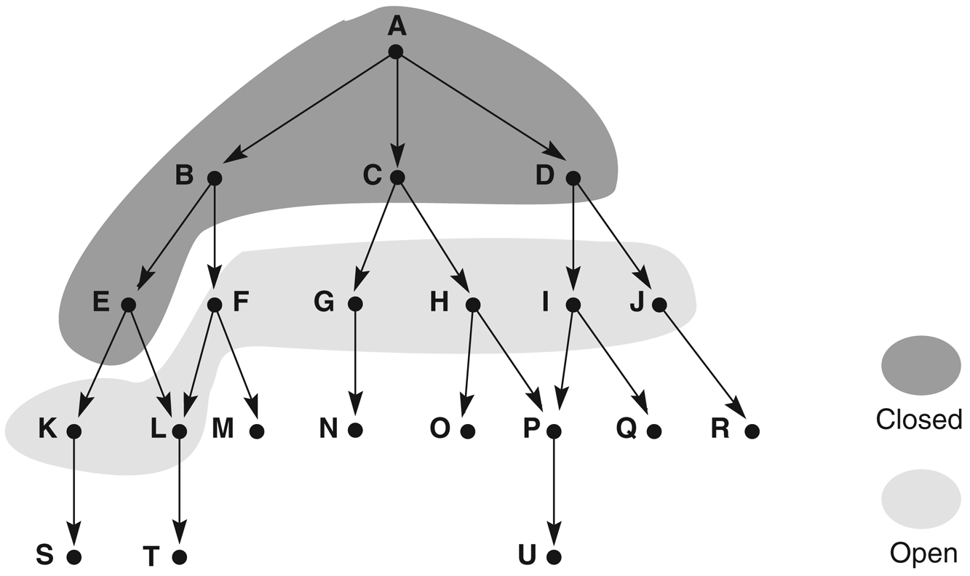
Graph of iteration of BFS

Slide 37
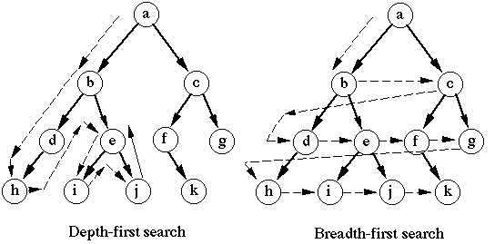

Slide 38
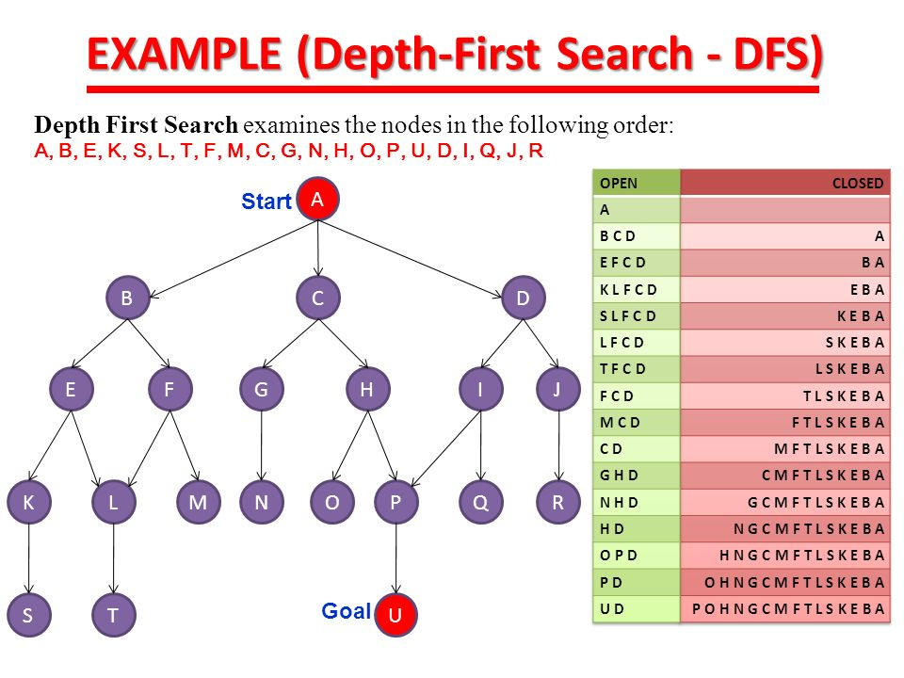

Slide 39
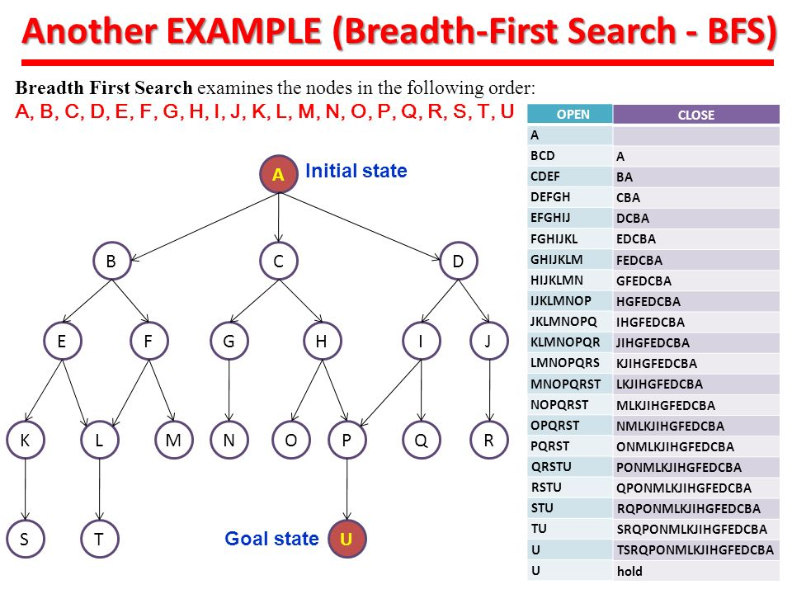

Slide 40
Strategies for state space search
A state may be searched in two directions:
  From the given data of a problem instance toward a goal or
  From a goal to the data

Slide 41
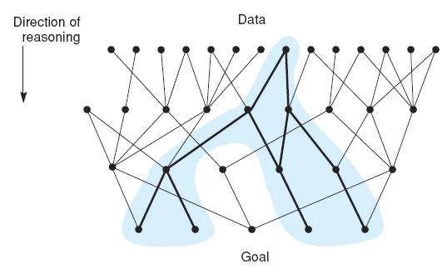
Strategies for state space search
In data driven search, also called forward chaining (deductive reasoning), the problem solver (algorithm) begins with the given facts of the problem and set of legal moves for changing state
This process continues until (we hope!!) it generates a path that satisfies the goal condition

Slide 42
Strategies for state space search
An alternative approach (Goal Driven) is start with the goal that we want to solve
See what rules can generate this goal and determine what conditions must be true to use them (inductive reasoning)
These conditions become the new goals
Working backward through successive sub-goals until (we hope again!) it work back to

Slide 43
Backward Vs Forward chaining
If more possible outcomes than initial states→ backward chaining will produce faster search with the shortest path
If more initial start states than there are goal states→ forward chaining

Slide 44
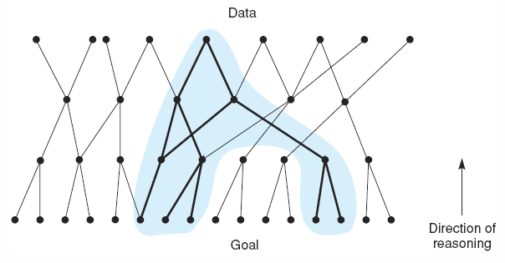
Strategies for state space search

Slide 45
Assignment 3
DFS and BFS implementation in any language (details next slide)
What is heuristic search, what are different heuristic algorithms? How it works ?
Note: First page of assignment should have your details such as name, roll no., shift.
Upload in turnitin deadline mentioned there.
Q1. run on the system.

Slide 46
DFS/BFS Programming assignment
Write a program that takes node values for a binary tree as inputs. It should store these values for possible representations of a binary tree. Then try a value to find out from this tree and tell how many comparisons are made up to the target node and also convey the level of tree at which the target value found.

Slide 47
Tree to be implemented
Tree to be implemented
S
A
B
C
D
E
F
G
H

Slide 48
References
Louis E. Frenzel, Jr. Crash crouse in artificial intelligence and expert system, chapter No.3

